Slide 1
Lincoln and the Emancipation Proclamation
Race Relations in the South 1863-1912
Unit 4

Slide 2
What motives lay behind Lincoln’s issuing of the Emancipation Proclamation?
Underlying questions:
What was the Emancipation Proclamation?
What effects did the Emancipation Proclamation have on slaves?
Why was the Emancipation Proclamation issued?

Slide 3
Resources
4 handouts
Encarta
Farmer
Zinn
Brogan
Willoughby p.19-29
Internet
www.sparatcus.schoolnet.co.uk/USASproclamation.htm
www.archives.gov/exhibits/featured_documents/emancipation_proclamation/index.html

Slide 4
Outcomes
Mind maps
Essay question
To what extent was Lincoln’s Emancipation Proclamation (1863) the result of a genuine desire to free blacks?
January 2003

Slide 5
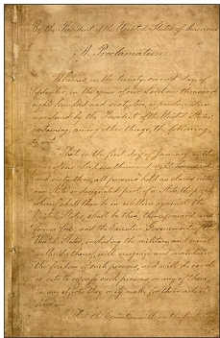
What was the Emancipation Proclamation
Preliminary proclamation issued 22nd Sept 1862
Freed all slaves who were in Confederate states fighting against the Union
Did not free all slaves! Was very limited.

Slide 6
Timeline
1861 Outbreak of Civil War
July 1861 Crittenden Resolutions
13 March 1862 Annulment of Fugitive Slave Laws
10 April 1862 Congress agree to compensate slave owners
19 June 1862 Congress rule slavery is illegal in U.S. territories

Slide 7
Timeline
July 1862 Confiscation Act
17 Sept 1862 Union victory at Antietam
22 Sept 1862 Preliminary Emancipation
Proclamation issued
1 Jan 1862 Emancipation Proclamation issued
31 Jan 1865 13th Amendment to the Constitution.

Slide 8
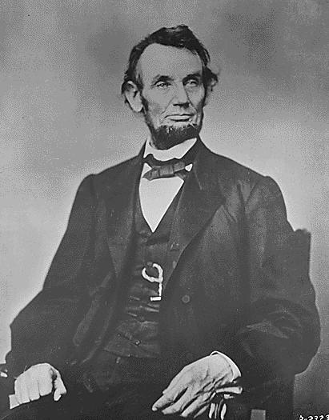
Why did Lincoln issue the Emancipation Proclamation? Lincoln’s views
Personal views
Political stance
Lincoln’s ideas on slavery
Slavery and the Civil War

Slide 9
Task
Using extracts from Lincoln’s letters and speeches brainstorm his views on slavery and the rights of Blacks under the following headings:
Personal views
Political stance
Lincoln’s views on slavery
Slavery and the Civil War

Slide 10
This powerpoint was kindly donated to www.worldofteaching.com
http://www.worldofteaching.com is home to over a thousand powerpoints submitted by teachers. This is a completely free site and requires no registration. Please visit and I hope it will help in your teaching.

